Slide 1
ENEL 419
Special Continuous Random Variables:
PDF, CDF, Mathematical Expectations, and Probability Calculations.
Reading Exercise: Montgomery and Runger Sections 4.4-4.7
(Reading Exercises: Yates and Goodman –Section 4.5-4.7)

Slide 2

Important Continuous Random Variables
Uniform Random Variable:
A continuous uniform random variable $X$ is equally likely to assume values in a finite interval $a≤X≤b$ . The PDF is equal to a constant,

Slide 3
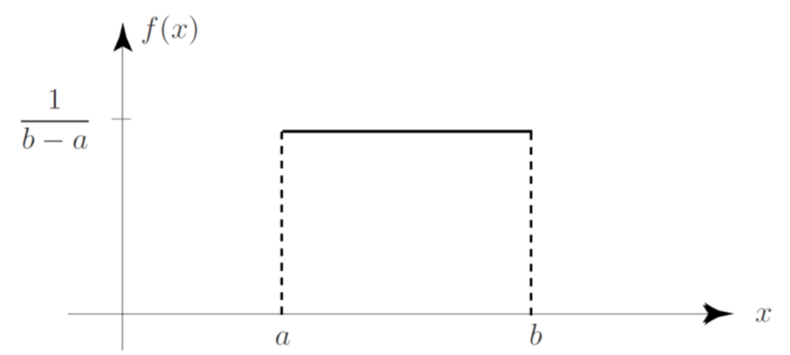
Uniform Random Variable
PDF of a Uniform Random Variable:

Slide 4
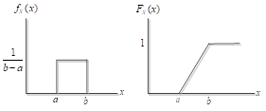
Uniform Random Variable
CDF of a Uniform Random Variable:

Slide 5
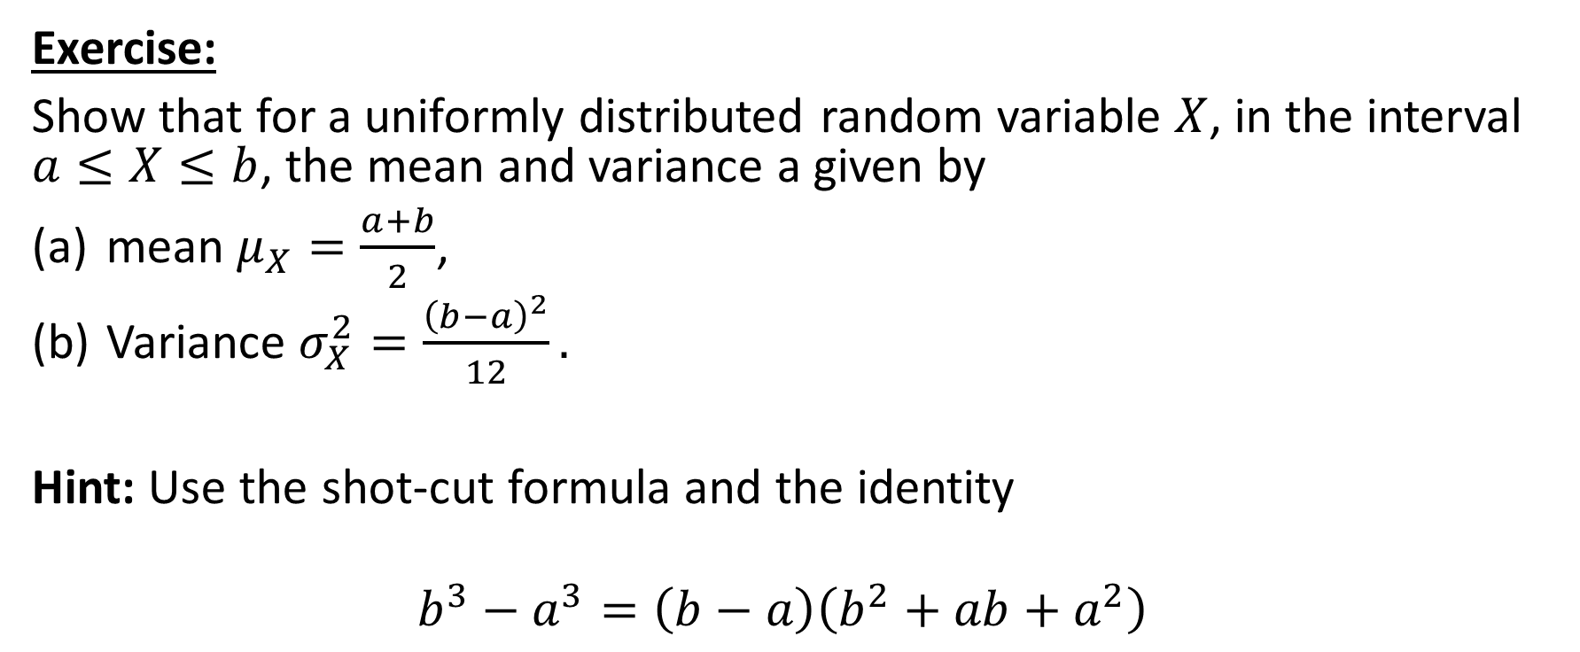
Mean and Variance of a Uniform Random Variable
Exercise:
Show that for a uniformly distributed random variable $X$, in the interval $a≤X≤b$, the mean and variance a given by
mean $μ_{X}=\frac{a+b}{2}$,
Variance $σ_{X}^{2}=\frac{{\left(b−a\right)}^{2}}{12}.$
Hint: Use the shot-cut formula and the identity
$$b^{3}−a^{3}=\left(b−a\right)\left(b^{2}+ab+a^{2}\right)$$

Slide 6

Example 5
Resistors are manufactured with a tolerance of $10\%$. Within this tolerance region, they are approximately uniformly distributed. Suppose the nominal value of each resistor is $1000Ω$. What is the probability that a randomly select resistor has a value in the range $900Ω≤R≤1010Ω$?

Slide 7
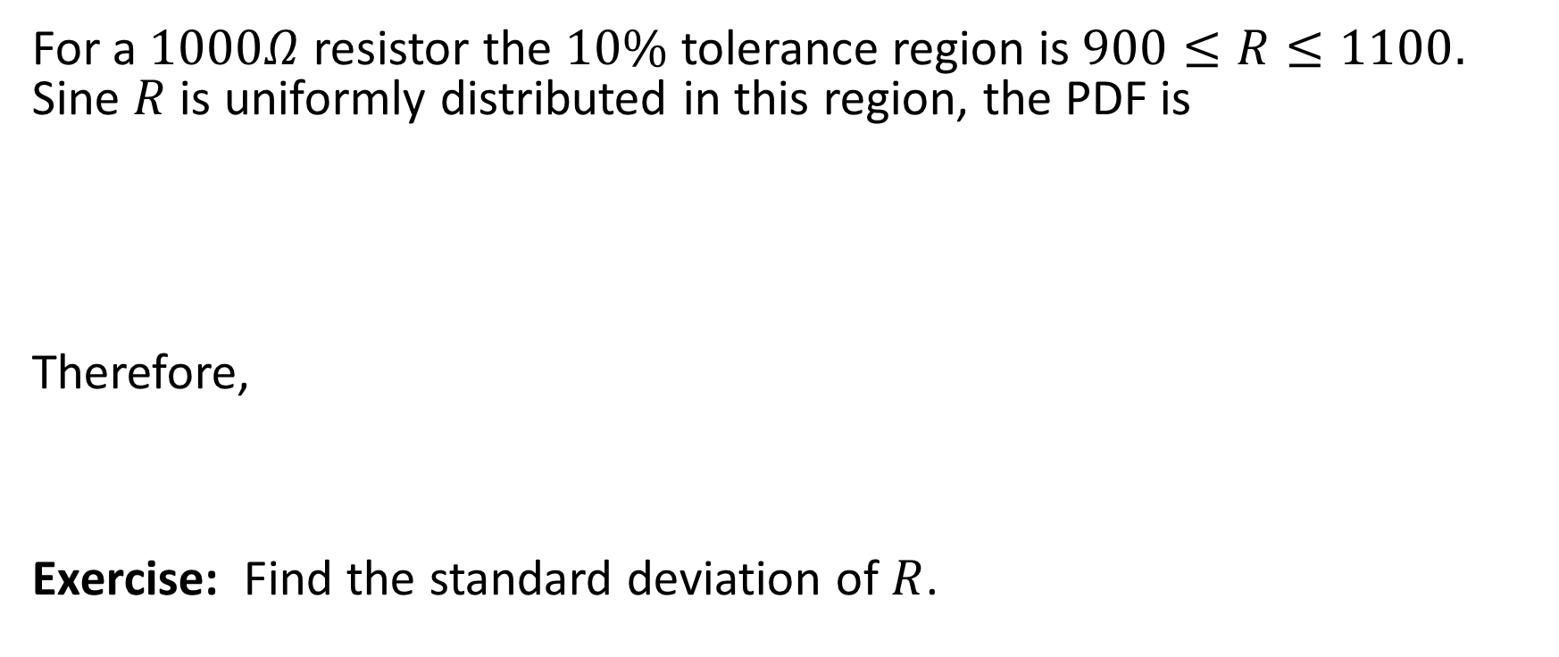
Example 5 Solution
For a $1000Ω$ resistor the $10\%$ tolerance region is $900≤R≤1100.$ Sine $R$ is uniformly distributed in this region, the PDF is
Therefore,
Exercise: Find the standard deviation of $R$.

Slide 8
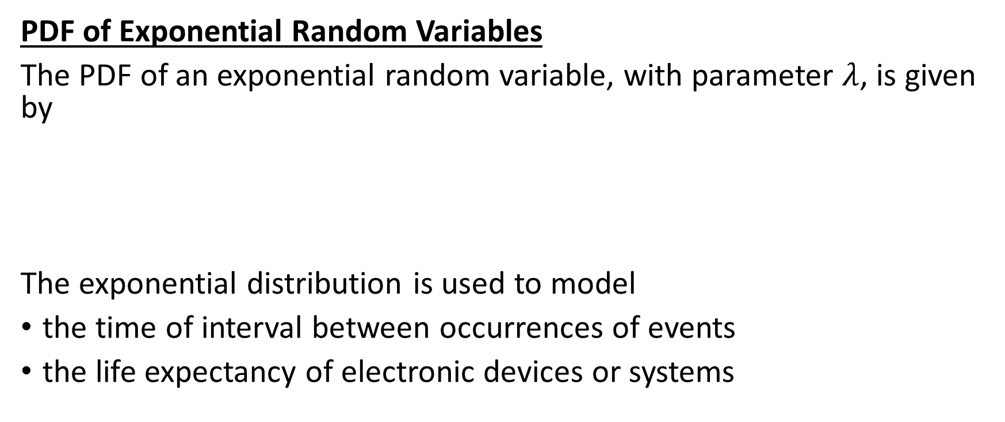
Exponential Random Variables
PDF of Exponential Random Variables
The PDF of an exponential random variable, with parameter $λ$, is given by
The exponential distribution is used to model
the time of interval between occurrences of events
the life expectancy of electronic devices or systems

Slide 9
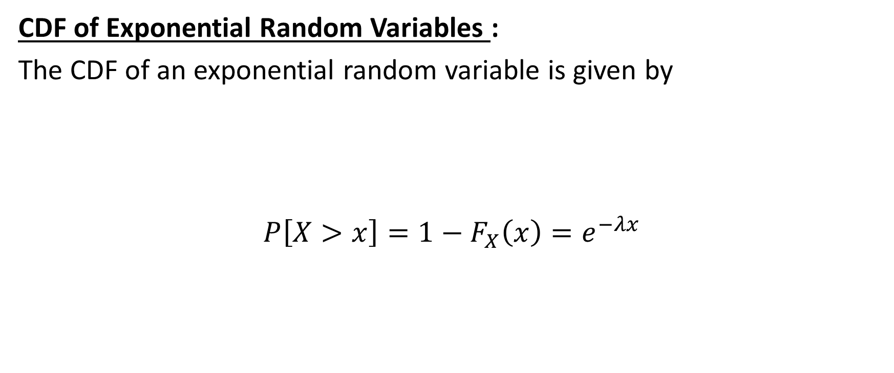
Exponential Random Variables
CDF of Exponential Random Variables :
The CDF of an exponential random variable is given by
$$P\left[X>x\right]=1−F_{X}\left(x\right)=e^{−λx}$$

Slide 10
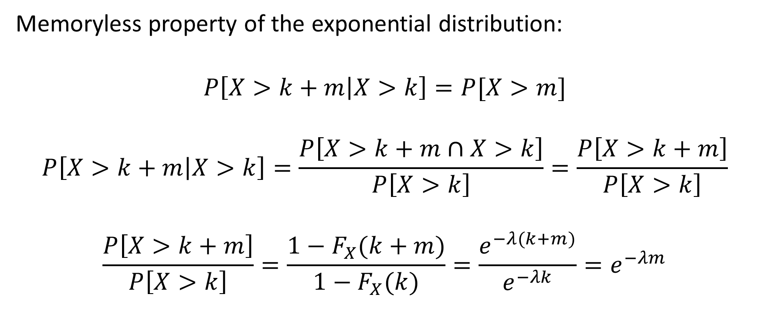
Exponential Random Variable
(Memoryless property)
Memoryless property of the exponential distribution:
$$P\left[X>k+m | X>k\right]=P[X>m]$$
$$P\left[X>k+m | X>k\right]=\frac{P\left[X>k+m∩X>k\right]}{P\left[X>k\right]}=\frac{P\left[X>k+m\right]}{P\left[X>k\right]}$$
$$\frac{P\left[X>k+m\right]}{P\left[X>k\right]}=\frac{1−F_{X}(k+m)}{1−F_{X}(k)}=\frac{e^{−λ(k+m)}}{e^{−λk}}=e^{−λm}$$

Slide 11
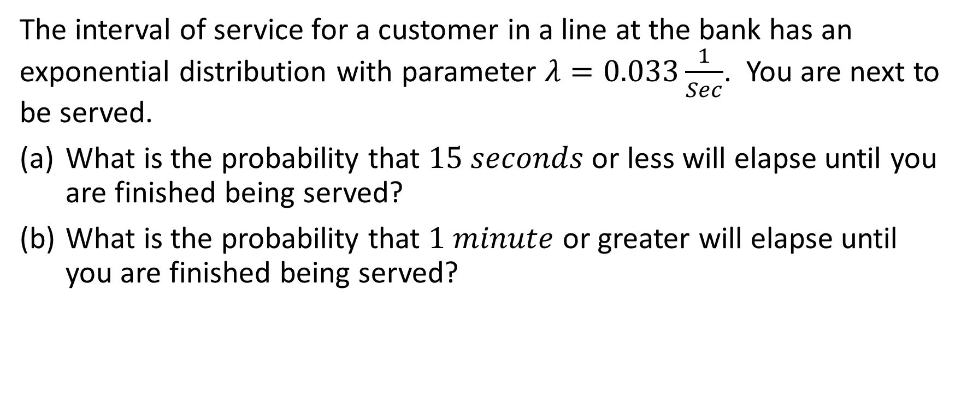
Example 6
The interval of service for a customer in a line at the bank has an exponential distribution with parameter $λ=0.033\frac{1}{Sec}$. You are next to be served.
What is the probability that $15 seconds$ or less will elapse until you are finished being served?
What is the probability that $1 minute$or greater will elapse until you are finished being served?

Slide 12
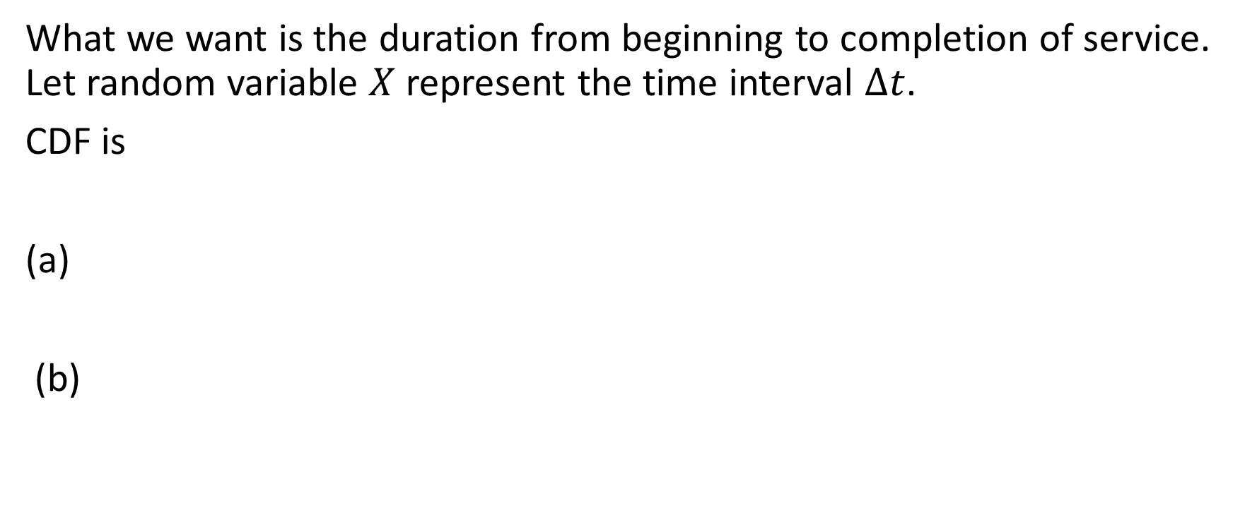
Example 6 Solutions
What we want is the duration from beginning to completion of service. Let random variable $X$ represent the time interval $∆t$.
CDF is
(a)
(b)

Slide 13
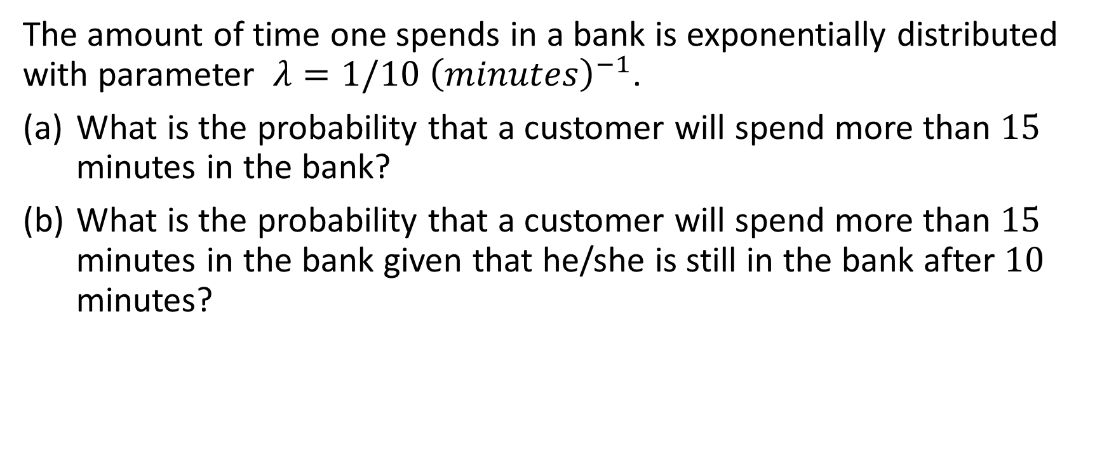
Example 7
The amount of time one spends in a bank is exponentially distributed with parameter $λ=1/10 {\left(minutes\right)}^{−1}$.
What is the probability that a customer will spend more than $15$ minutes in the bank?
What is the probability that a customer will spend more than $15$ minutes in the bank given that he/she is still in the bank after $10$ minutes?

Slide 14

Example 7
(a)
(b) Use memoryless property
$$P\left[X>k+m | X>k\right]=P[X>m]$$

Slide 15
Mean of and Variance Value of Exponential Random Variables
Mean of Exponential Random Variables :

Slide 16
Mean of and Variance Value of Exponential Random Variables
Variance of Exponential Random Variables :

Slide 17
Gaussian (or Normal) Random Variable:
A Gaussian random variable is the single most widely used in practice.
• Many physical phenomena in electrical engineering are modeled by the Gaussian distribution.
• If the model of a continuous RV is unknown, we can conveniently use the Gaussian model.

Slide 18
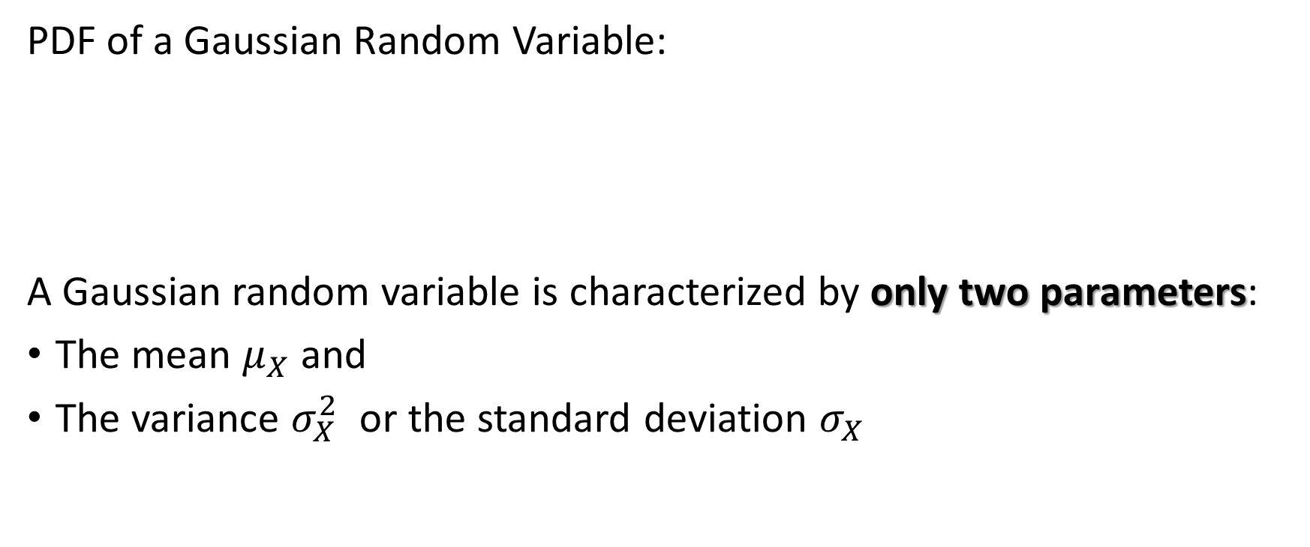
The PDF of a Gaussian Random Variable
PDF of a Gaussian Random Variable:
A Gaussian random variable is characterized by only two parameters:
The mean $μ_{X}$ and
The variance $σ_{X}^{2}$ or the standard deviation $σ_{X}$

Slide 19
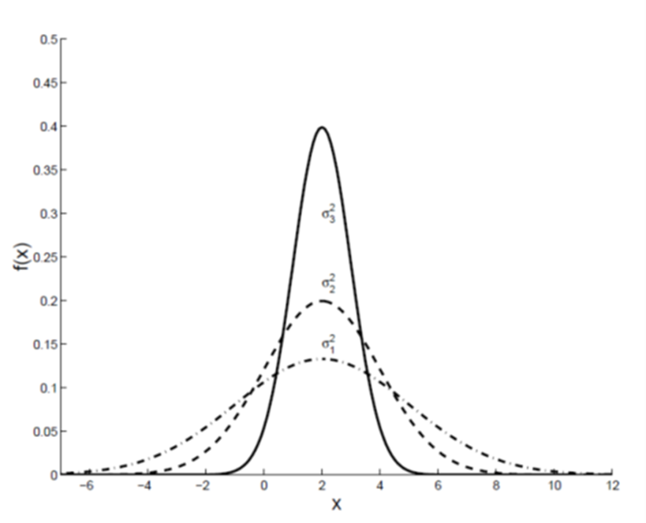
Example PDF of a Gaussian Random Variable

Slide 20
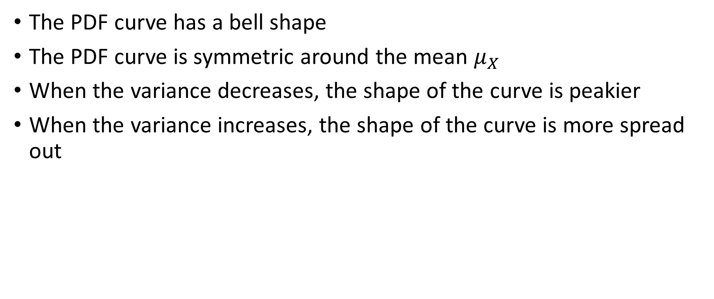
Properties of the Gaussian PDF
The PDF curve has a bell shape
The PDF curve is symmetric around the mean $μ_{X}$
When the variance decreases, the shape of the curve is peakier
When the variance increases, the shape of the curve is more spread out

Slide 21
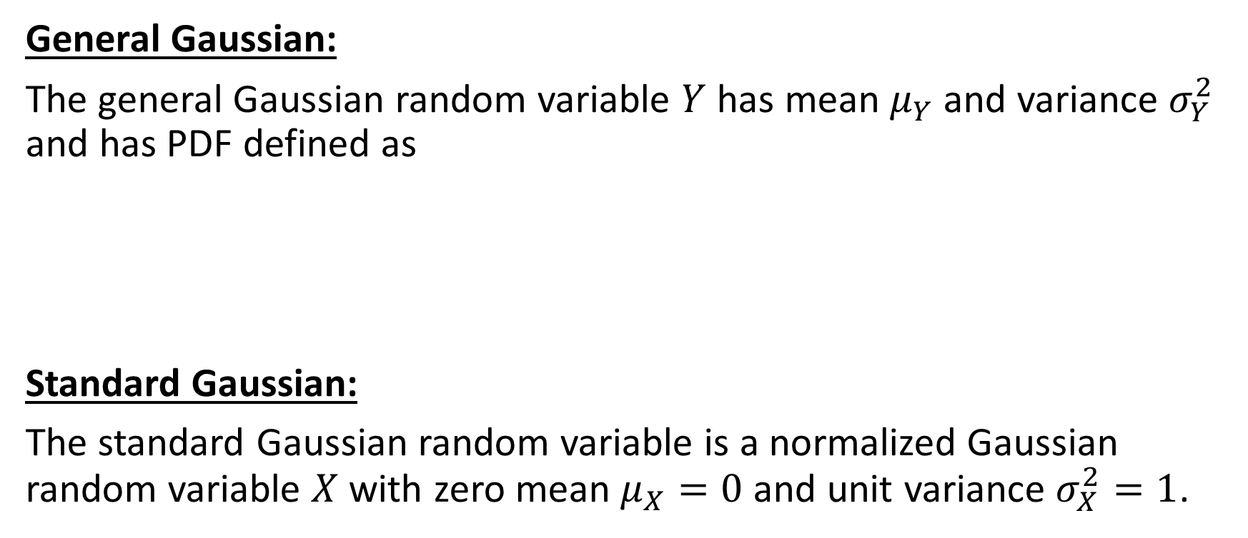
General Gaussian (Normal) Distribution
General Gaussian:
The general Gaussian random variable $Y$ has mean $μ_{Y}$ and variance $σ_{Y}^{2}$ and has PDF defined as
Standard Gaussian:
The standard Gaussian random variable is a normalized Gaussian random variable $X$ with zero mean $μ_{X}=0$ and unit variance $σ_{X}^{2}=1$.

Slide 22
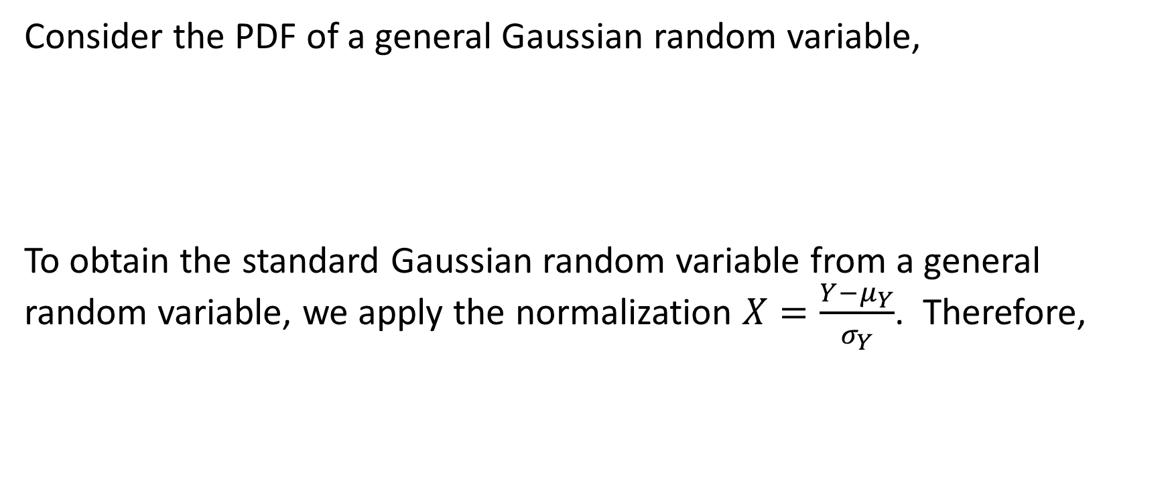
Standard Gaussian(Normal) Distribution
Consider the PDF of a general Gaussian random variable,
To obtain the standard Gaussian random variable from a general random variable, we apply the normalization $X=\frac{Y−μ_{Y}}{σ_{Y}}$. Therefore,

Slide 23
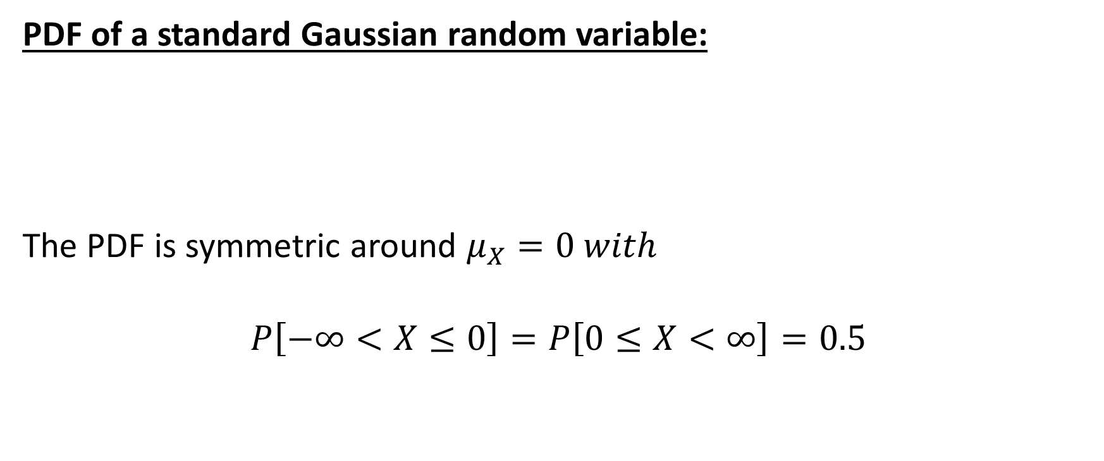
Standard Gaussian(Normal) Distribution
PDF of a standard Gaussian random variable:
The PDF is symmetric around $μ_{X}=0 with$
$$P\left[−∞<X≤0\right]=P\left[0≤X<∞\right]=0.5$$

Slide 24
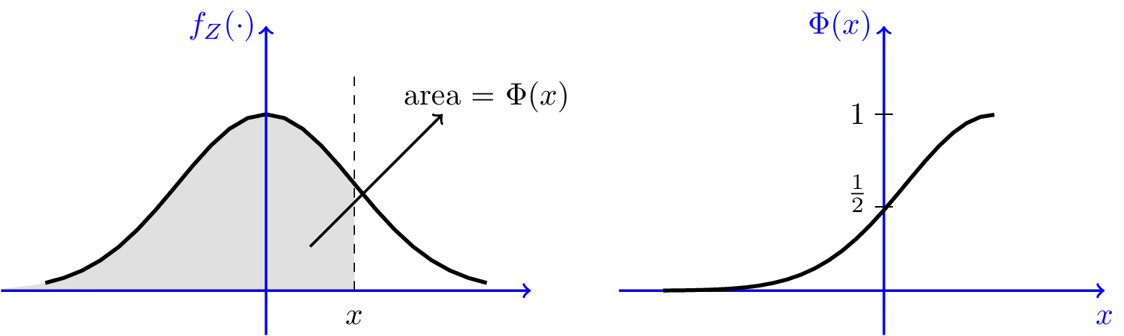
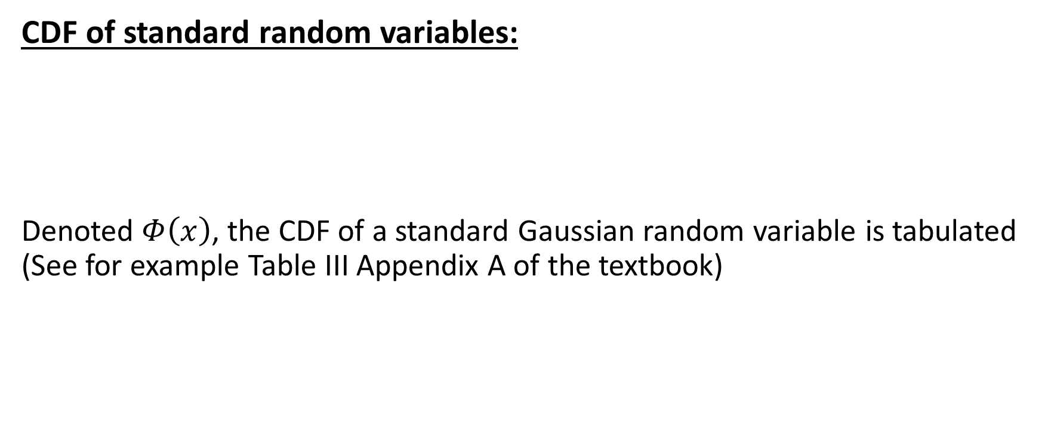
CDF of Standard and Regular Gaussian Random Variables
CDF of standard random variables:
Denoted $Φ\left(x\right)$, the CDF of a standard Gaussian random variable is tabulated (See for example Table III Appendix A of the textbook)

Slide 25

CDF of Standard and Regular Gaussian Random Variables
CDF of regular Gaussian random variables:
We can express this in terms of the $Φ(.)$ by using a change of variable,

Slide 26
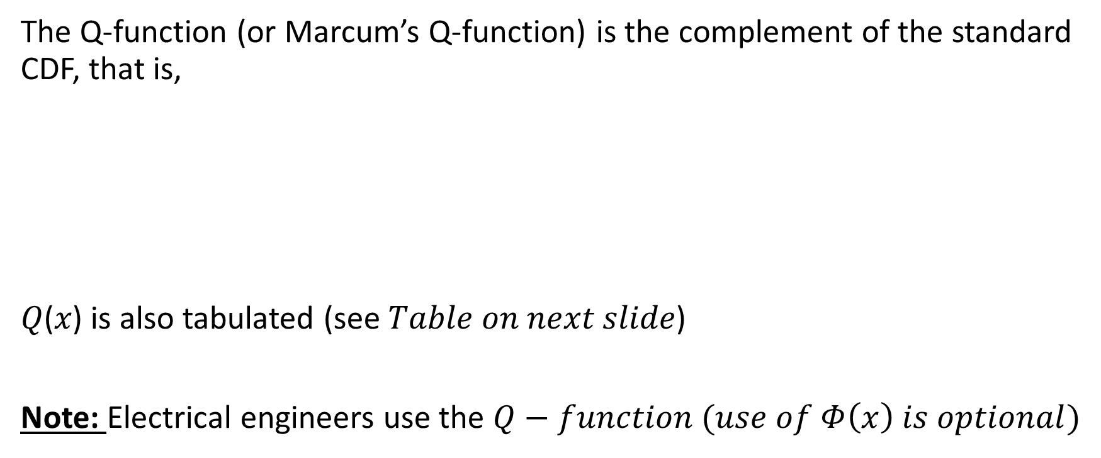
The Q-Function
The Q-function (or Marcum’s Q-function) is the complement of the standard CDF, that is,
𝑄(𝑥) is also tabulated (see 𝑇𝑎𝑏𝑙𝑒 𝑜𝑛 𝑛𝑒𝑥𝑡 𝑠𝑙𝑖𝑑𝑒)
Note: Electrical engineers use the $Q−function (use of Φ\left(x\right) is optional)$

Slide 27
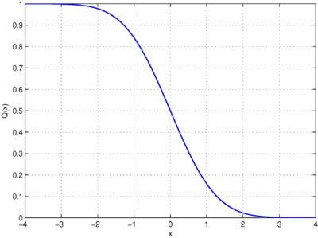
Q-Function Table

Slide 28
CDF of Regular Gaussian Random Variables
CDF of regular Gaussian random variables in terms of the Q-function:

Slide 29

Properties of the Q-Function
Symmetry: $Q\left(−γ\right)=1−Q\left(γ\right), γ>0$
$Q\left(0\right)=0.5$
$Q\left(−∞\right)=0$
$Q\left(∞\right)=1$
$Q\left(x\right)$ is monotonically decreasing (waterfall shape)

Slide 30
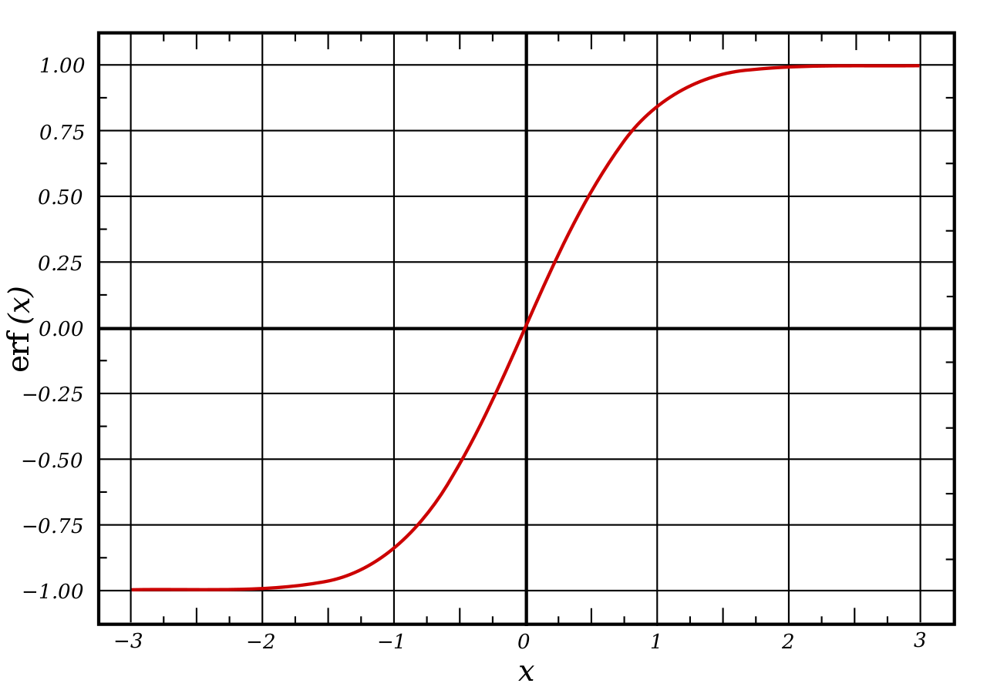

Error Function and Complementary Error Function - $erf\left(x\right) and erfc\left(x\right)$

Slide 31

Applications of the Gaussian Distribution
Example 8: A certain type of battery lasts, on average, $3$ years with a standard deviation of $0.5$ years. Assuming battery life is Gaussian distributed. Find the probability that a given battery will last no more than $2.3$ years.

Slide 32

Example 8 Solution
We are given $μ_{X}=3 and σ_{X}=0.5$. We need to find $P\left[X≤2.3\right]$
To use the Q-function, convert to the complement

Slide 33
Applications of the Gaussian Distribution
Example 9:
For the same battery life problem in Example 8, what is the probability that a given battery will last between 1.5 to 2 years?

Slide 34

Example 9 Solution
We are given $μ_{X}=3 and σ_{X}=0.5$. We need to find $P\left[1.5≤X≤2\right]$

Slide 35
Applications of the Gaussian Distribution
Example 10: What is the probability that the battery in Example 8 will last between 3 to 4 years?
Solution:

Slide 36
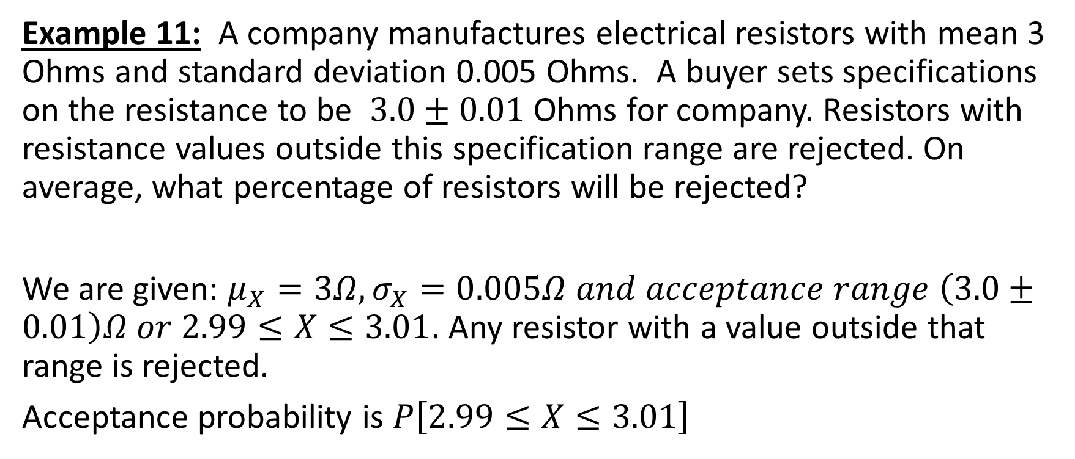
Applications of the Gaussian Distribution
Example 11: A company manufactures electrical resistors with mean 3 Ohms and standard deviation 0.005 Ohms. A buyer sets specifications on the resistance to be $3.0±0.01$ Ohms for company. Resistors with resistance values outside this specification range are rejected. On average, what percentage of resistors will be rejected?
We are given: $μ_{X}=3Ω, σ_{X}=0.005Ω and acceptance range \left(3.0±0.01\right)Ω or 2.99≤X≤3.01$. Any resistor with a value outside that range is rejected.
Acceptance probability is $P\left[2.99≤X≤3.01\right]$

Slide 37

Example 11 Solution
Rejection probability is the complement of acceptance probability,
Percentage of resistors rejected$=100×P_{reject}=4.55\%$

Slide 38
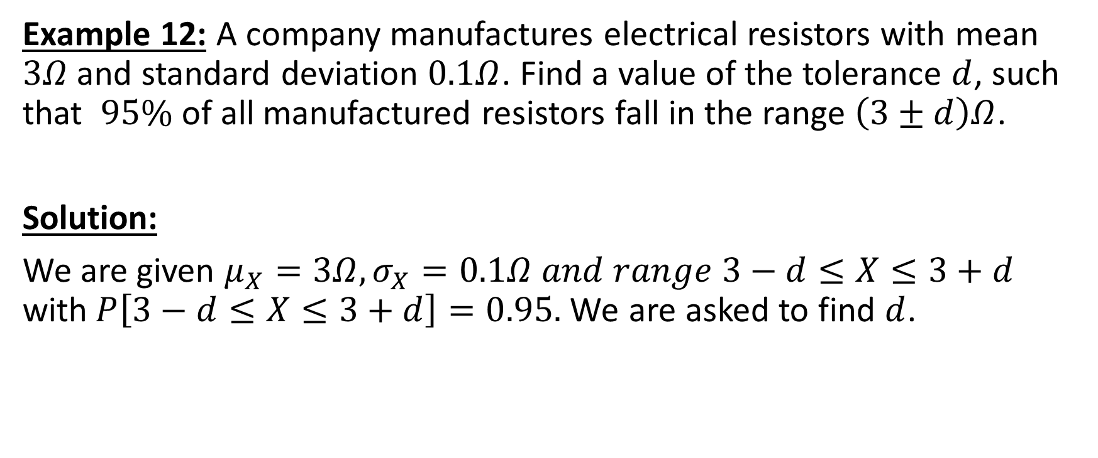
Applications of the Gaussian Distribution
Example 12: A company manufactures electrical resistors with mean $3Ω$ and standard deviation $0.1Ω$. Find a value of the tolerance $d$, such that $95\%$ of all manufactured resistors fall in the range $\left(3±d\right)Ω$.
Solution:
We are given $μ_{X}=3Ω, σ_{X}=0.1Ω and range 3−d≤X≤3+d$ with$P\left[3−d≤X≤3+d\right]=0.95.$We are asked to find $d$.

Slide 39

Example 12 Solution
We want to find $d.$

Slide 40

Applications of the Gaussian Distribution
Example 13: A radar system receives a signal with background noise. The background noise follows a Gaussian distribution with a mean of $0V$ and a standard deviation of $0.45V.$ The radar system assumes that an enemy airplane is detected if the received voltage exceeds $0.9V$. What is the probability of False Alarm?

Slide 41

Example 13 Solution
False alarm: when the system thinks there is a target when there is none.
$$X=\left\{\begin{aligned}s+noise, target present \\ & noise, no target present\end{aligned}\right.$$

